Slide 1
CLASS 9 SCIENCE | CHAPTER 2 | NCERT 2026–27
🦠
CELL
The Building Block of Life
🔬 MICROSCOPY
🧬 DNA & GENES
⚡ CELL ORGANELLES
🌱 CELL DIVISION
🔬

Slide 2
Introduction to Cells
Every living thing is made of cells
🔍 ZOOM IN...
🔑 Cell is the Structural & Functional Unit of Life
👤 Human Body (1.7 m)
🫀 Organ (Heart) (~12 cm)
🦠
🧫
Unicellular
Multicellular
🧱 Tissue (mm scale)
Single cell does all life functions
Ex: Amoeba, Bacteria
Millions of cells work together
Ex: Plants, Animals, Humans
🔬 Cell (10–100 µm)
All organisms — from bacteria to blue whale — are made of cells
🧬 DNA (2 nm wide)
Cell carries out metabolism, growth, reproduction & response

Slide 3
Origin of Life & Hot Springs
Life first emerged in warm, mineral-rich water bodies on early Earth
🌍
Early Earth
♨️
Hot Springs
~4 billion years ago
Hydrothermal vents
Hot, volcanic, rich in chemicals — perfect for first life forms
Warm water with minerals supported first thermophilic bacteria
🏔️
Puga Valley
🦠
Thermophiles
Ladakh, India
Heat-loving bacteria
Active geothermal area — real-life example of life in extreme heat
Survive 60–80°C! Proof life adapts to extreme environments
💡 KEY INSIGHT: The conditions in hot springs mimic early Earth's primordial soup where life first appeared!

Slide 4
Discovery of the Cell
🪵
Cork cells look like
honeycomb boxes
1590
1665
1674
1839
Microscope Invented
Cell Discovered
Living Cells Seen
Cell Theory Proposed
Janssen Brothers
Robert Hooke
Antonie van Leeuwenhoek
Schleiden & Schwann
🔬 Robert Hooke (1665) — observed thin slices of cork under a microscope and named the tiny compartments "CELLS" (from Latin 'cellula' = small room)

Slide 5
Microscope & Resolution
👁️
Human Eye
Cannot see individual cells
Resolution: 0.1 mm
(100 µm)
Magnification: 10x
💡
Light Microscope
See cells & large organelles
Resolution: 200 nm
(0.2 µm)
Magnification: 1,000x
⚡
Electron Microscope
See viruses, DNA, proteins
Resolution: 0.2 nm
(0.0002 µm)
Magnification: 500,000x
💡 Resolution = ability to distinguish two nearby points as separate

Slide 6
Structure of a Light Microscope
👁️ Eyepiece (Ocular Lens)
You look through here
Magnifies 10x
🔧 Body Tube
Connects eyepiece
to objective lens
🎯 Objective Lens
4x, 10x, 40x, 100x
Primary magnification
📋 Stage
Holds the glass slide
with specimen
🪞 Mirror/Light Source
Directs light through
the specimen
⚙️ Adjustment Knobs
Coarse & fine focus
for sharp image

Slide 7
Activity: Estimating Cell Size
🧅 Onion Peel Experiment
🧅
Step 1
💧
Step 2
Peel a thin layer from an onion
Place on glass slide with water
🔬
Step 3
🔢
Step 4
Observe under light microscope
Count cells across field of view
📐 FORMULA TO ESTIMATE CELL SIZE
Estimated Size of Cell = Diameter of Field of View ÷ Number of Cells
💡 Example: Field diameter = 1.5 mm, Cells across = 15 → Cell size = 1.5 ÷ 15 = 0.1 mm = 100 µm

Slide 8
Cell Theory
🌿
🐾
🔬
Matthias Jakob
Schleiden
Theodor Schwann
Rudolf Virchow
1838
1839
1855
All plants are made of cells
All animals are made of cells
Cells arise from pre-existing cells
(Omnis cellula e cellula)
THREE POSTULATES OF CELL THEORY
1
All living organisms are composed of one or more cells
2
The cell is the basic structural and functional unit of life
3
All cells arise from pre-existing cells (biogenesis)

Slide 9
Types of Cells
🦠 PROKARYOTIC CELL
🧫 EUKARYOTIC CELL
Feature
Prokaryotic
Eukaryotic
Nucleus
No true nucleus
(nucleoid region)
True nucleus
with nuclear membrane
Size
0.1–10 µm
(very small)
10–100 µm
(larger)
Membrane organelles
Absent
Present (ER, Golgi, etc.)
DNA
Circular, naked DNA
Linear DNA with histones
Cell wall
Present (peptidoglycan)
Present in plants
(cellulose)
Examples
Bacteria, Archaea
Plants, Animals,
Fungi, Protists
💡 Pro = before | Karyon = nucleus Eu = true | Karyon = nucleus

Slide 10
Cell Membrane (Plasma Membrane)
🧪 FLUID MOSAIC MODEL
🔒
Selectively Permeable
Controls what enters/exits the cell
🧬
Made of Lipids & Proteins
Phospholipid bilayer + embedded proteins
⬅️ OSMOSIS (Water movement)
🌊
Osmosis
Low
Concentration
(Hypotonic)
High
Concentration
(Hypertonic)
Water moves from low → high concentration
💨
Diffusion
→→→ H₂O
Semipermeable Membrane
Substances move from high → low concentration
⚡
Active Transport
Moves substances AGAINST concentration gradient

Slide 11
Osmosis Experiment
🥔 Potato Osmosis Experiment
💧
⚖️
🔥
HYPOTONIC SOLUTION
ISOTONIC SOLUTION
HYPERTONIC SOLUTION
Water concentration OUTSIDE > Inside
Water concentration EQUAL on both sides
Water concentration INSIDE > Outside
Result:
Result:
Result:
Cell absorbs water → SWELLS / TURGID
No net movement → Cell STAYS SAME
Cell loses water → SHRINKS / PLASMOLYSIS
[Low Salt]
[Equal Salt]
[High Salt]
🌱 In plants: Turgid cell (full water) = firm plant | Flaccid cell (lost water) = wilted plant

Slide 12
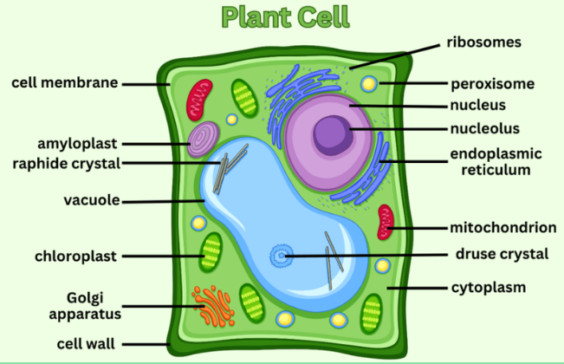
Cell Wall
🌿 Present ONLY in Plant Cells, Fungi & Bacteria — NOT in Animal Cells
PLANT CELL DIAGRAM
🧱
Made of Cellulose
A tough polysaccharide fiber
that provides rigidity & shape
🛡️
Protective Layer
Outermost layer — protects
cell from physical damage
💪
Provides Shape
Maintains definite shape
in plant cells
🌊
Freely Permeable
Allows water, gases and
nutrients to pass freely

Slide 13
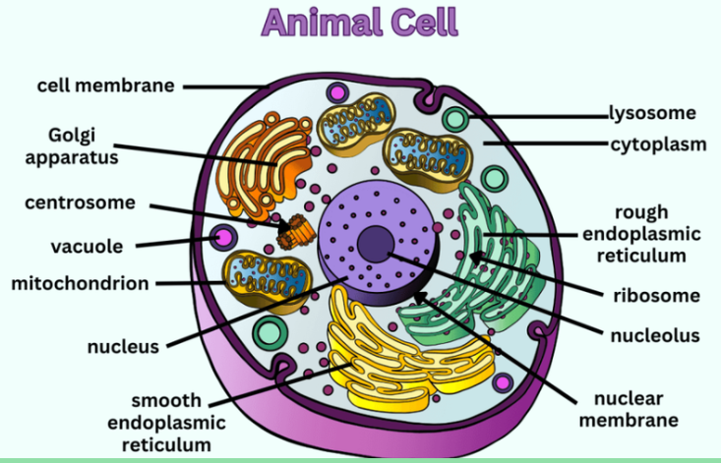

Slide 14
Plant Cell vs Animal Cell
🌱 PLANT CELL
🐾 ANIMAL CELL
✅ Present (cellulose)
Cell Wall
❌ Absent
Fixed rectangular shape
Shape
Irregular / round shape
✅ Present (chloroplasts)
Plastids
❌ Absent
✅ Large central vacuole
Vacuole
Small/absent vacuoles
Peripheral (side)
Nucleus Position
Central position
❌ Absent (mostly)
Centrioles
✅ Present
Rare
Lysosomes
✅ Abundant
Photosynthesis (chloroplast)
Energy source
Cellular respiration only

Slide 15
Cell Organelles — Overview
Organelles are tiny organs inside the cell — each with a specific function
🔵
Nucleus
⚡
Mitochondria
🏭
Rough ER
Control center
Energy factory
Protein synthesis
🔄
Smooth ER
📦
Golgi Body
🗑️
Lysosome
Lipid synthesis
Packaging & shipping
Waste digestion
⚙️
Ribosome
💧
Vacuole
🌿
Chloroplast
Protein building
Storage tank
Photosynthesis

Slide 16
The Nucleus
🔵 Control Center of the Cell | Contains the Genetic Blueprint of Life
NUCLEUS STRUCTURE
Nuclear Membrane
Double-layered envelope with nuclear pores
Controls movement in/out of nucleus
Chromatin / DNA
Long DNA strands with proteins (histones)
Contains all genetic information (genes)
Nucleolus
Chromosomes
Condensed chromatin during cell division
Humans have 46 chromosomes (23 pairs)
Nucleolus
Nuclear membrane
(Double layer)
Dense body inside nucleus
Produces ribosomal RNA (rRNA)
🧬 DNA → Gene → Chromosome → Nucleus → Cell

Slide 17
Endoplasmic Reticulum (ER)
A network of membranes extending from the nucleus — like a factory + highway system
🏭
🔄
ROUGH ER (RER)
SMOOTH ER (SER)
▸ Has ribosomes on surface
(makes it look 'rough')
▸ NO ribosomes on surface
(smooth appearance)
▸ Manufactures and processes
proteins for cell/export
▸ Synthesizes lipids and
phospholipids (cell membrane)
▸ Connected to nuclear envelope
▸ Detoxifies drugs & poisons
in liver cells
▸ Found in protein-secreting
cells like pancreas
▸ Stores calcium ions
(important for muscles)
📌 Example: Antibody-producing cells
📌 Example: Liver cells, muscle cells

Slide 18
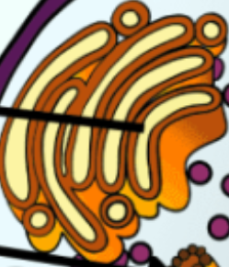
Golgi Apparatus
📦 The Post Office / Courier Service of the Cell — Packages & Ships Materials
GOLGI STRUCTURE
📬
Modification
Receives proteins from ER and
modifies/tags them for destinations
📦
Packaging
Wraps materials in membrane
vesicles (transport packages)
🚚
Secretion
Ships vesicles to cell membrane
for export outside the cell
🏷️
Lysosome Formation
Creates lysosomes by packaging
digestive enzymes
🔬 Discovered by Camillo Golgi in 1897 | Found in secretory cells — goblet cells, pancreatic cells

Slide 19
Lysosomes
💥 The Suicidal Bags of the Cell — Contain Powerful Digestive Enzymes
🗑️ HOW LYSOSOMES WORK
🔬
Formation
Made by Golgi apparatus
Contain ~50 enzymes
1️⃣ Golgi forms lysosome
Packages hydrolytic enzymes
💊
Enzyme Type
Hydrolytic enzymes
Work in acidic pH (5.0)
2️⃣ Lysosome attacks
Fuses with worn-out organelle
🧹
Autophagy
Digests old/damaged
cell organelles
3️⃣ Enzymes digest it
Breaks down proteins, lipids, DNA
🦠
Phagocytosis
Digests bacteria eaten
by white blood cells
4️⃣ Monomers recycled
Nutrients reused by cell
☠️
Autolysis
Cell self-destruction
(programmed cell death)
⚠️ Autolysis: Self-destruction of damaged cells

Slide 20
Mitochondria
⚡ THE POWERHOUSE OF THE CELL — Generates ATP Energy for all life processes
⚡ MITOCHONDRIA STRUCTURE
🍬
Glucose Input
C₆H₁₂O₆ + O₂
(from food you eat)
↓
⚙️
Cellular Respiration
Reactions in matrix
& cristae
Matrix
↓
⚡
ATP Output
36–38 ATP molecules
= Energy for cell
Outer membrane →
Inner membrane →
Cristae (folds) →
↓
💨
By-products
CO₂ + H₂O
(exhaled/released)
🧬 Mitochondria have their OWN DNA — evidence of endosymbiotic origin!

Slide 21
Plastids
🌿 Present ONLY in Plant Cells | Three types based on color & function
🌿
🍊
🤍
CHLOROPLAST
CHROMOPLAST
LEUCOPLAST
Contains green pigment
chlorophyll
Contains colored pigments
(carotenoids, xanthophylls)
Colorless plastid
(no pigment)
Function:
Function:
Function:
Photosynthesis:
6CO₂ + 6H₂O → C₆H₁₂O₆ + 6O₂
Gives color to
flowers and fruits
Stores starch, oils,
and proteins
Found in: leaves, green parts
Found in: petals, ripe fruits
Found in: roots, seeds, tubers
☀️→🍬
🌸🍎🥕
🥔🌾
💡 Leucoplast → Chromoplast → Chloroplast (plastids can convert into each other!)

Slide 22
Vacuole
💧 Storage Compartment of the Cell | Large in plants, small in animals
PLANT vs ANIMAL CELL VACUOLE
🌊
Turgidity
Full vacuole = turgid (firm) plant
Empty vacuole = wilted plant
Nucleus
🧂
Osmoregulation
Controls water balance
in the cell
💧
♻️
Waste Storage
Large Central
Vacuole
(90% cell volume)
Nucleus
Stores metabolic waste
products safely
Small vacuoles
(scattered)
🍬
Food Vacuole
🌱 PLANT CELL
🐾 ANIMAL CELL
In Amoeba — engulfs food
and digests it
💊
Contractile Vacuole
In Paramecium — pumps
excess water out

Slide 23
Cell Division — Introduction
One cell splits into two — the fundamental process behind growth, repair & reproduction
📈
🩹
🌱
GROWTH
REPAIR
REPRODUCTION
From one fertilized egg to trillions of cells in your body!
Cell division increases cell number.
Damaged or dead cells are replaced by new cells through division.
Ex: Skin heals after a cut.
Single-celled organisms reproduce by simply dividing into two new organisms.
Ex: Bacteria, Amoeba.
TWO TYPES OF CELL DIVISION
⚡ MITOSIS — 2 identical daughter cells (body cells)
🌸 MEIOSIS — 4 gametes with half chromosome number
🔬 Observable in: Onion root tip cells — dividing cells visible under microscope!

Slide 24
Mitosis
⚡ Produces 2 Genetically Identical Daughter Cells | Used for Growth & Repair
⭕
🧵
⬛
↕️
⭕⭕
INTERPHASE
PROPHASE
METAPHASE
ANAPHASE
TELOPHASE
Cell prepares for division.
DNA replicates (copied).
Cell grows in size.
Chromosomes condense
& become visible.
Nuclear envelope breaks.
Chromosomes align
at cell's equator.
Spindle fibers attach.
Chromatids pulled
to opposite poles.
Cell elongates.
Two nuclei form.
Chromosomes decondense.
Cell pinches in.
→
→
→
→
RESULT: 1 Parent Cell → 2 Daughter Cells
📍 Location: Somatic (body) cells
📍 Purpose: Growth, repair, asexual reproduction
✅ Genetically IDENTICAL
✅ Same chromosome number (diploid 2n)

Slide 25
Meiosis
🌸 Produces 4 Genetically Different Gametes | Used for Sexual Reproduction
MEIOSIS I (Reductive division)
MEIOSIS II (Equational division)
Prophase I
Metaphase I
Anaphase I
Telophase I
Prophase II
Metaphase II
Anaphase II
Telophase II
Homologous chromosomes
pair up (synapsis)
Crossing over occurs!
Pairs align at
cell equator
Homologs pulled
to opposite poles
2 cells form
(still diploid-like)
Each cell prepares
for 2nd division
Chromosomes align
in each cell
Chromatids pulled
apart
4 haploid cells
(gametes) form!
🔀 CROSSING OVER
RESULT: 1 Diploid Cell (2n) → 4 Haploid Gametes (n)
Exchange of genetic material between homologous chromosomes → creates genetic variation!
Sperm + Egg → each with HALF the chromosome number
Humans: 2n=46 → n=23 chromosomes in each gamete

Slide 26
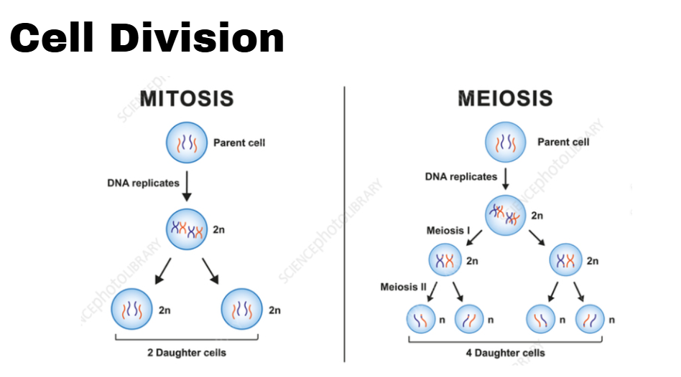

Slide 27
Mitosis vs Meiosis
Feature
⚡ MITOSIS
🌸 MEIOSIS
Number of cells produced
2 daughter cells
4 daughter cells
Chromosome number
Remains 2n (diploid)
Reduced to n (haploid)
Genetic outcome
Genetically identical
Genetically different
Divisions
1 division only
2 divisions (I & II)
Crossing over
Does NOT occur
Occurs in Prophase I
Purpose
Growth & repair
Sexual reproduction
Where it occurs
Somatic (body) cells
Gonads (sex organs)
In humans
All body cells
Testes & Ovaries
💡 Meiosis maintains the chromosome number across generations — without it, chromosome numbers would double each generation!

Slide 28
Cancer: Uncontrolled Cell Division
⚠️ When cell division goes WRONG — cells divide uncontrollably forming a tumor
✅ NORMAL CELLS
❌ CANCER CELLS
Divide in controlled, regulated manner
Divide without control or limits
Stop dividing when enough cells exist
Don't stop even when overpopulated
Have normal shape and function
Abnormal shape and function
Stay in their original tissue
Can spread to other tissues (metastasis)
Die naturally (apoptosis) when needed
Ignore apoptosis signals
🔬 Causes: Mutations in DNA | Radiation | Carcinogens | Viruses | 🏥 Treatment: Surgery, Chemotherapy, Radiation therapy

Slide 29
Synthetic Cells & Future Science
🔮 Scientists have created the first synthetic cell — the future of biology is here!
🧬 J. CRAIG VENTER EXPERIMENT (2010)
🚀 FUTURE APPLICATIONS
1. Created a synthetic genome in laboratory
💊 Medicine: Designer cells to cure diseases
2. Inserted it into a living bacterial cell
⚡ Biofuel: Synthetic cells producing clean energy
3. Cell began to function normally!
🧹 Bioremediation: Cells that eat plastic/pollution
4. Called 'JCVI-syn1.0' — first synthetic life
🥗 Agriculture: Custom crops with perfect nutrients
⚠️ ETHICAL CONSIDERATIONS
• Is creating life ethical?
• Who controls synthetic organisms?
• Biosafety risks if released
• Need international regulation
🌟 Synthetic biology could revolutionize medicine, energy, and the environment in the 21st century!

Slide 30
Important Scientists in Cell Biology
🔬
🌿
🐾
Robert Hooke
Schleiden
Schwann
1665
1838
1839
Discovered & named 'Cells'
Observed cork under microscope
All plants made of cells
Co-founder of Cell Theory
All animals made of cells
Extended Cell Theory
🧬
📦
🇮🇳
Rudolf Virchow
Camillo Golgi
Arun Kumar Sharma
1855
1897
20th C
Cells arise from existing cells
'Omnis cellula e cellula'
Discovered Golgi apparatus
Nobel Prize 1906
Indian cytologist
Contributed to plant cytogenetics
🏆 Science is built on centuries of curiosity, observation, and collaboration!

Slide 31
Chapter Summary — Mind Map
🧬 Cell Theory
Schleiden, Schwann, Virchow
🔬 Discovery
Hooke 1665
🦠 Types
Prokaryotic vs Eukaryotic
🔬
CELL
♨️ Origin
Hot springs, Primordial soup
🧱 Organelles
Nucleus, Mito, ER, Golgi...
💧 Membrane
Osmosis, Diffusion, Transport
⚡ Cell Division
Mitosis & Meiosis
🌿 Plant Features
Cell wall, Plastids, Vacuole

Slide 32
G·C·A·T·G·C·A·T·G·C·A·T·G·C·A·T·G·C·A·T·G·C·A·T·G·C·A·T·G·C·A·T·G·C
🧬
Thanks for Watching!
Cell: The Building Block of Life | Class 9 Science Chapter 2
👍 LIKE
📤 SHARE
🔔 SUBSCRIBE
🔑 KEY TAKEAWAYS
Cell = Unit of Life | Prokaryotic vs Eukaryotic | Organelles = Cell factories | Mitosis = Growth | Meiosis = Reproduction

